Slide 1
1
Displaying the Order in a Group of Numbers Using Tables and Graphs

Slide 2
Statistics
Statistics – branch of math that focuses on the interpretation of a group of numbers

Slide 3
Two Branches of
Statistical Methods
Descriptive statistics
  Summarize/organize scores from a research study
Inferential statistics
  Draw conclusions/make inferences that go beyond the scores from a research study

Slide 4
Basic Concepts
Variable
  A characteristic that can have different values
Value
  A possible number or category that a score can have
Score
  A particular person’s value on a variable

Slide 5
Example
A 20 year old has a score of 20 on the variable age
Thus, this person’s score of 20 is one of many possible values of age
The variable in this case is age

Slide 6
Levels of Measurement
Types of Variables
  Continuous variables – infinite numbers of values between each point
  Discrete variables – have specific values and cannot have values in between.
Copyright © 2009 Pearson Education, Inc. Upper Saddle River, NJ 07458. All rights reserved.

Slide 7
Levels of Measurement
Continuous Variables (numeric)
Equal-interval variables – numbers that have equal intervals between values
  Ratio scales – and equal interval variable with a true zero point
  True zero – means the absence of something
  e.g., GPA vs Temperature

Slide 8
Levels of Measurement
Continuous Variables
  Rank-order (ordinal) variables
    e.g., class rank

Slide 9
Levels of Measurement
Discrete Variables
Nominal (categorical) variables
  e.g., gender

Slide 10
Frequency Tables
Provide a listing of individuals having each of the different values for a particular variable.
Stress ratings of 30 students: 8,7,4,10,8,6,8,9,9,7,3,7,6,5,0,9,10,7,7,3,6,7,5,2,1,6,7,10,8,8

Slide 11
Steps for Making a
Frequency Table
Make a list down the page of each possible value, from lowest to highest
Go one by one through the scores, making a mark for each next to its value on the list
Make a table showing how many times each value on the list is used
Figure the percentage of scores for each value

Slide 12
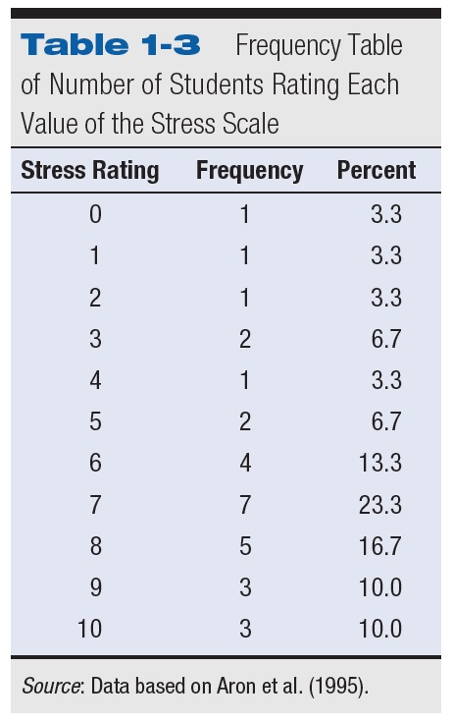
A Frequency Table

Slide 13
Uses of Frequency Tables
Describes the data
Makes the pattern of the data clear
Shows how many scores there were for each value on the scale

Slide 14
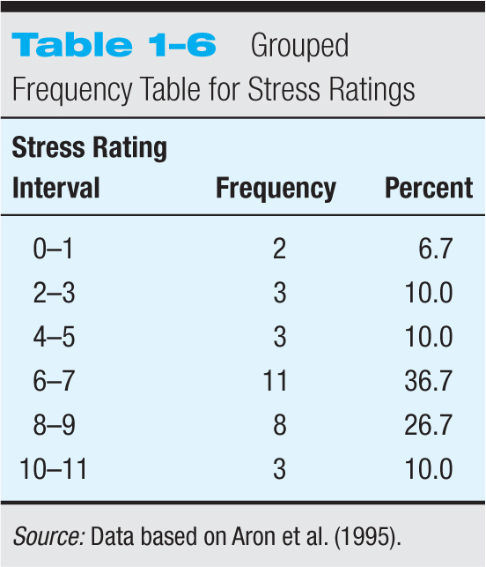
Grouped Frequency Table
A frequency table that uses intervals
Copyright © 2009 Pearson Education, Inc. Upper Saddle River, NJ 07458. All rights reserved.

Slide 15
Frequency Tables
Histograms – a barlike graph of frequency distribution in which values are plotted

Slide 16
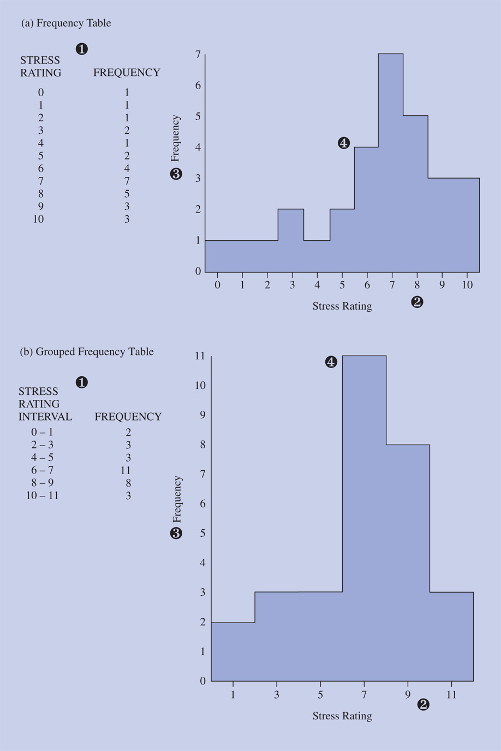
Histogram
Note: A bar chart would be used to display nominal data

Slide 17
Shapes of Frequency Distributions
Unimodal – one peak, one value has clearly a larger frequency
Bimodal – two peaks, two approximately equal frequencies
Multimodal – two more high frequencies
Rectangular – all values have about the same frequency

Slide 18
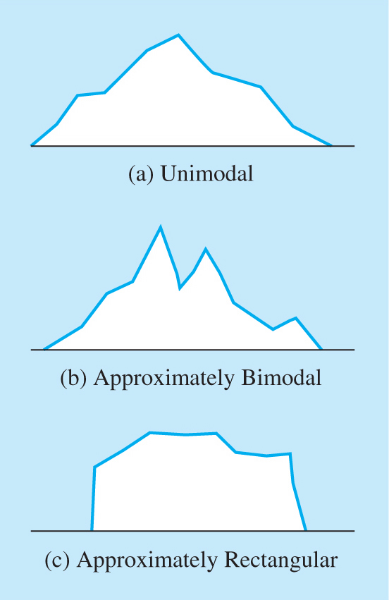
Shapes of Frequency Distributions
Unimodal, bimodal, and rectangular
Copyright © 2009 Pearson Education, Inc. Upper Saddle River, NJ 07458. All rights reserved.

Slide 19
Shapes of Frequency Distributions
Symmetrical – left and right side mirror each other on the distribution
Skewed – scores pile up on one side of the middle

Slide 20
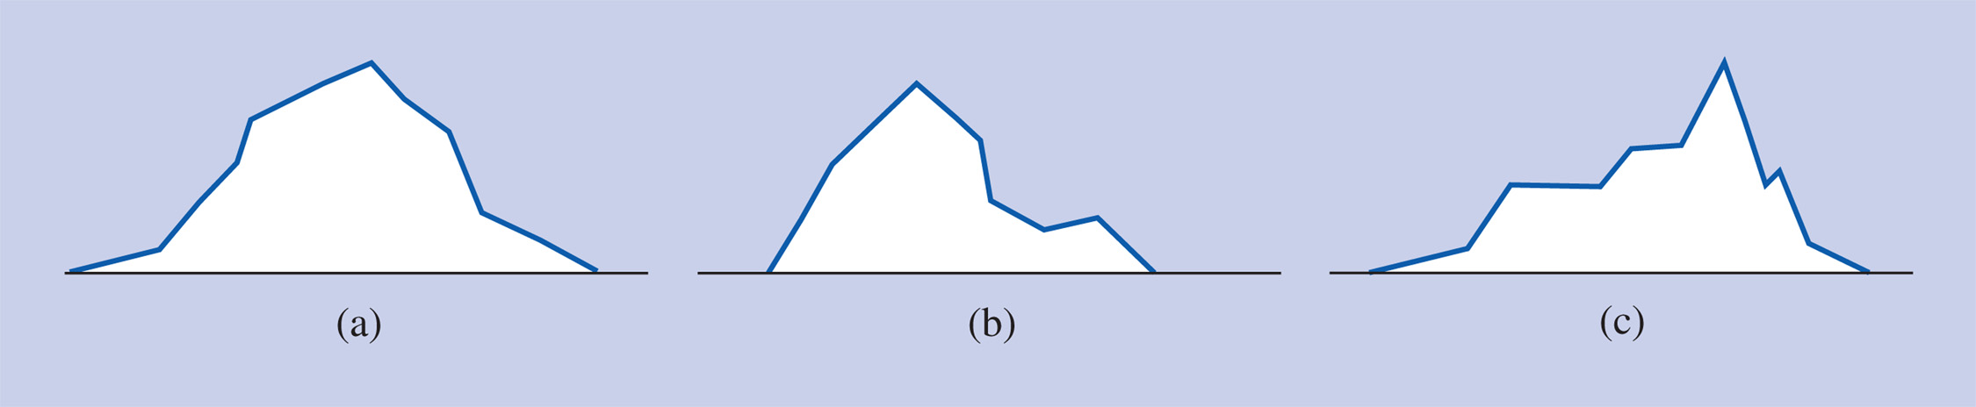
Shapes of Frequency Distributions -2
Symmetrical and skewed distributions

Slide 21
Skew
Skew is all about the tail of the distribution
Positive skew – all the stuff piles up on the left, tail is to the right
Negative skew – all the stuff piles up on the right, tail is to the left

Slide 22
Shape of Frequency Distributions
Floor effect – scores pile up at the low end of the distribution
Ceiling effect – scores pile up at the high end of the distribution

Slide 23
Shapes of Frequency Distributions
Normal – bell shaped frequency
  Symmetrical and unimodal
Kurtosis – how much a distribution deviates from normal

Slide 24
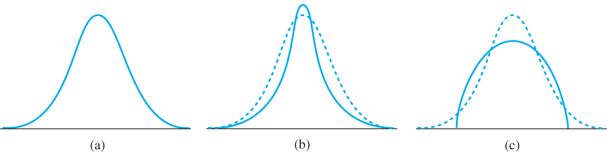
Shapes of Frequency Distributions -3
Normal and kurtotic distributions

Slide 25
Controversies and Limitations of Graphs
Failure to use equal interval sizes
Exaggeration of proportions

Slide 26
How to:
Frequency table
Histogram

